Slide 1
MSI pre-processing GUI
ZT group, Imperial College London

Slide 2
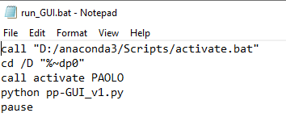
Pre-requisites:
-Initial installation is identical to that of the py_DESI_MSI_TOF, please refer to existing instructions, notably check that you have:
Anaconda (which should include Python 3.x & latest R)
Created a corresponding environment (see py_DESI_MSI_TOF document) to install required packages & dependencies.
-After installation, in the GUI folder, there is a file named ‘run_GUI.bat’, right-click to edit in notepad:
Make the modifications:
Change to your root Anaconda directory (wherever you installed Anaconda)
Change to the environment name that you have chosen during installation.
1
2
*If you have not installed the pre-processing module before, first cd to the GUI directory, then create a new environment e.g. NEWENV by:
conda env create -f guiEnv.yml --name NEWENV
And modify the environment name as above accordingly.

Slide 3
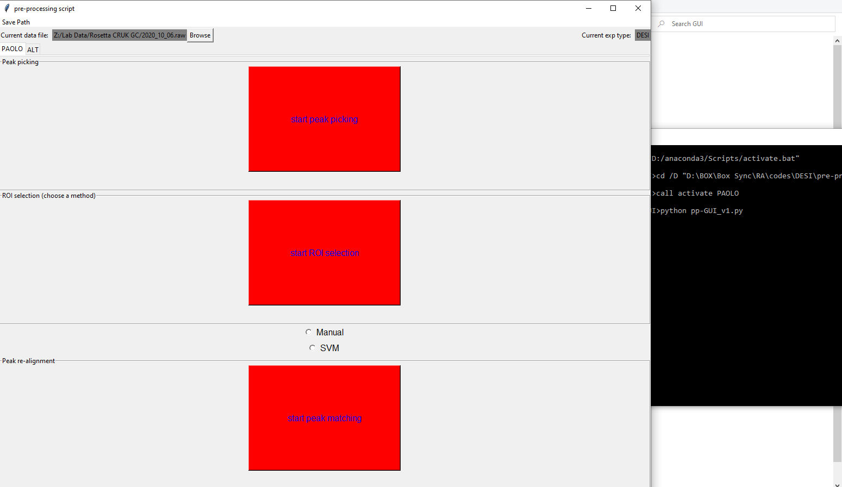
Example (liver data in the ‘test data’ folder):
1. Double-click ‘run_GUI.bat’ after making the modifications to start the GUI
-The main interface will appear and the command window is also accessible in the background to provide more information on the current process.

Slide 4
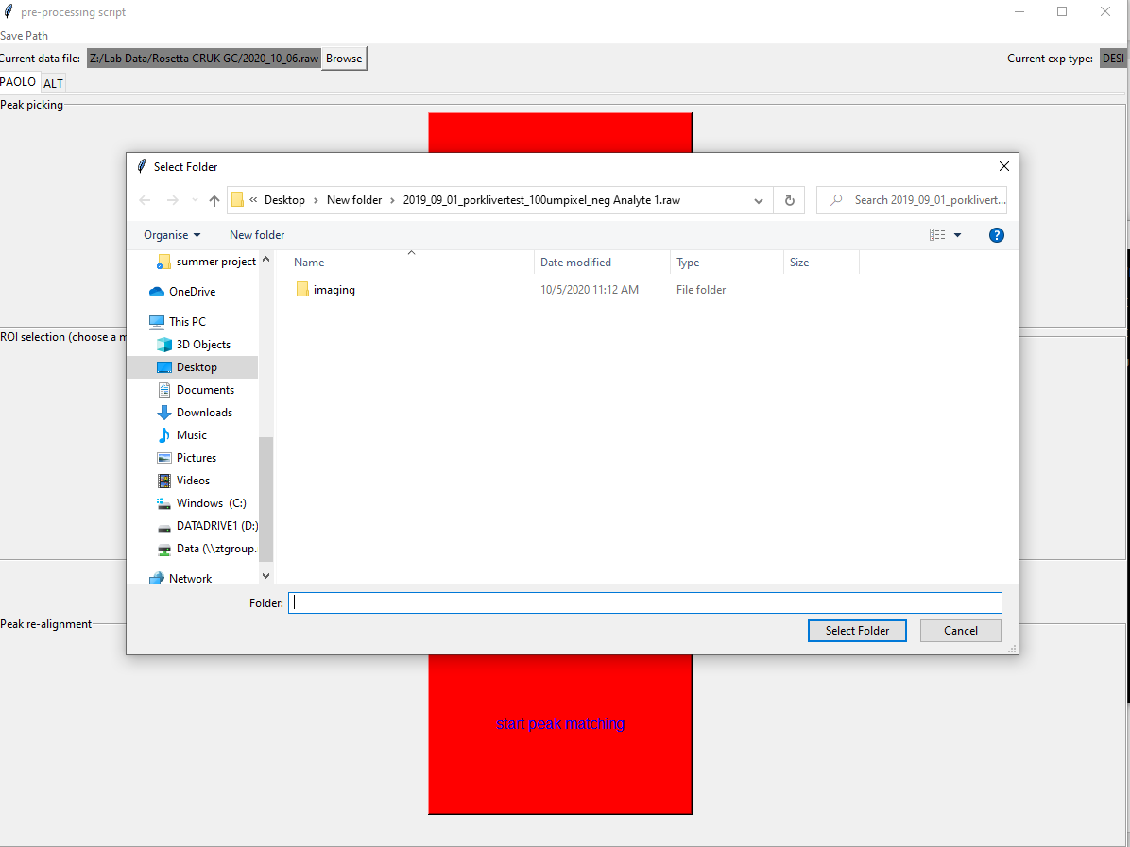
2. First, choose a raw file to process by selecting ‘Browse’ and a window will appear for you to select the desired raw file. Note to select ‘into’ the .raw folder as well, after which your Current data file should display e.g.

Slide 5
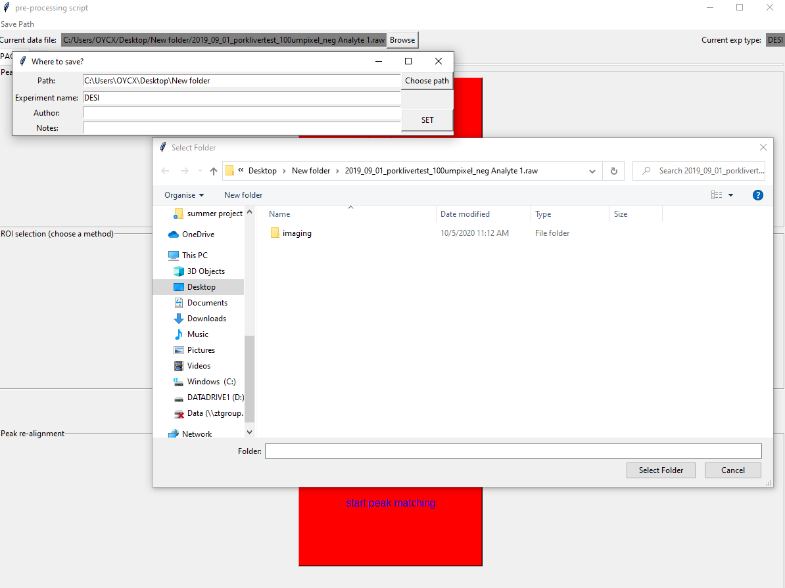
2. The default save path will be the same folder that contains the ‘.raw’ folder, you can change that freely by selecting ‘Save Path’, then ‘Choose path’. Click ‘SET’ after choosing a new save path.

Slide 6
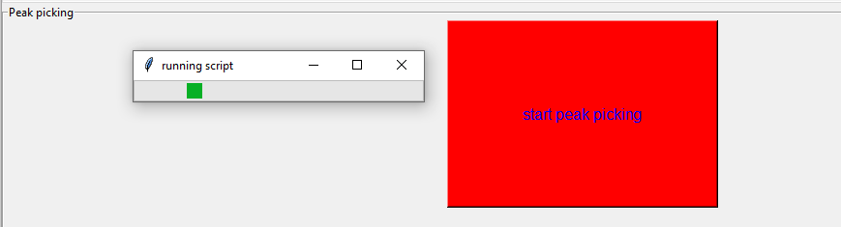
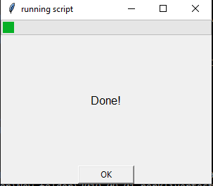
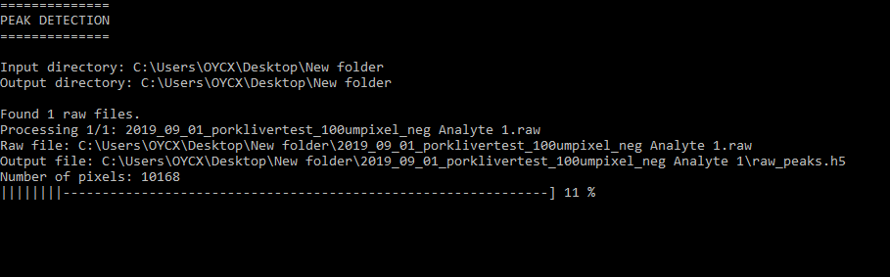
3. Start pre-processing with peak picking, simply click ‘start peak picking’, a progress bar will appear to show that the script has started running successfully. The command window in the background also displays the more exact progress.
A window will appear to notify you when the process has finished, just click ‘OK’ to continue.

Slide 7
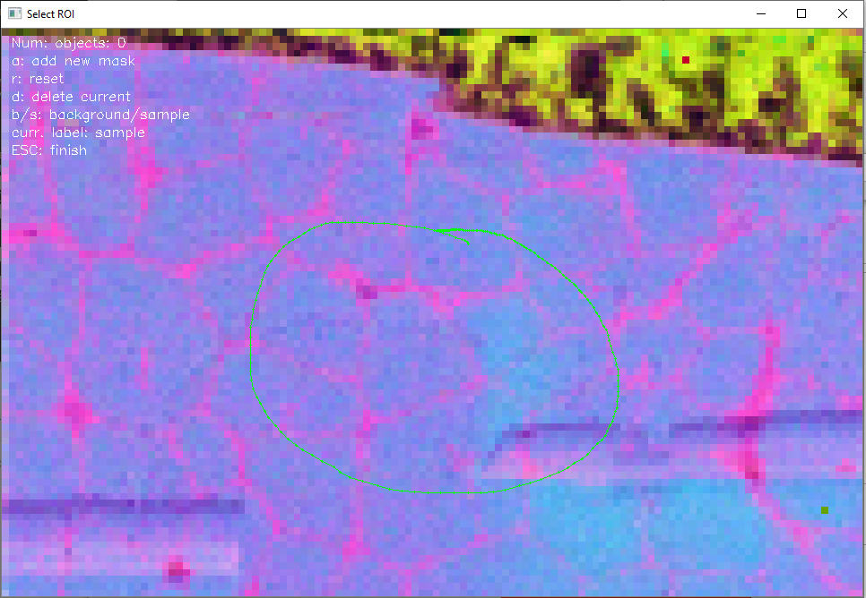
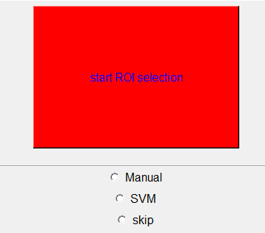
4. To then perform ROI selection, first select a method that you want to use, i.e. SVM (supervised) or Manual, by checking the corresponding selection box and then ‘start ROI selection’.
Once the script has finished binning the raw spectra to provide a reference image, the image window will pop up. Perform ROI selection accordingly, then press ‘Esc’ to finish the process.
(as of V2, this step can also be skipped.)

Slide 8
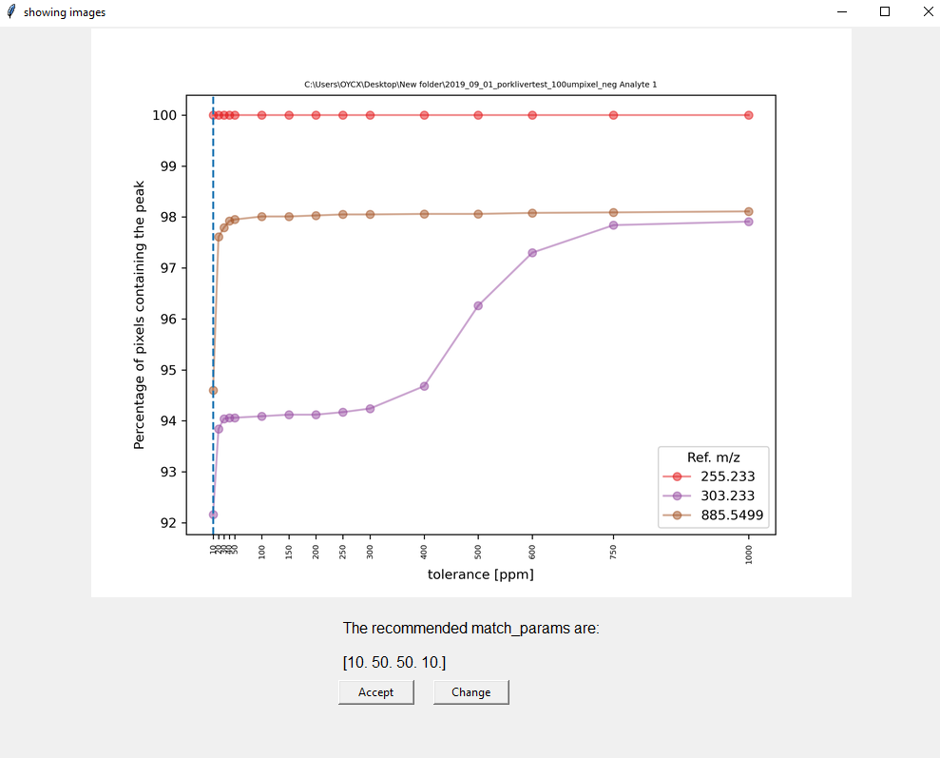
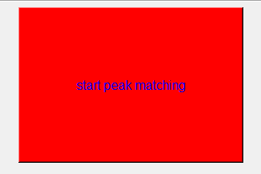
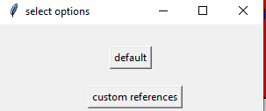
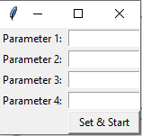
5. Finally, re-align the picked peaks in the selected ROI by pressing ‘start peak matching’, a window will then give you the opportunity to use custom-defined reference masses*. After selecting an option, the script will start to diagnose the inter-pixel drift of these reference masses.
Once this is completed, the diagnostic results will be displayed in a new window, along with recommended parameters for peak re-alignment. ‘Accept’ these parameters and start re-alignment or ‘Change’ them to your desired numbers and start.
Close the GUI normally after completion.
*V2

